Slide 1
Weekly Project Update
Daniil Karbukov
Laurent Bialylew
Wenhao Xie

Slide 2
Work done this week
01
02
03
04
Created UMLS
System setup
Created new class, use case, and sequence diagrams
Setup ReactJS frontend, Django backend, and PostgreSQL database
Added functions
Create Readme.md
Implement the CRUD methods
Created Readme file

Slide 3
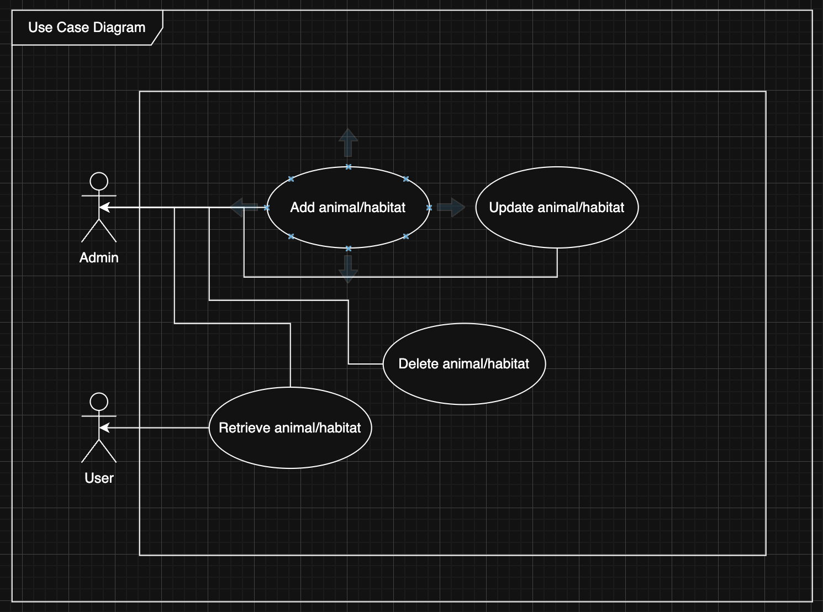
Use case UML

Slide 4
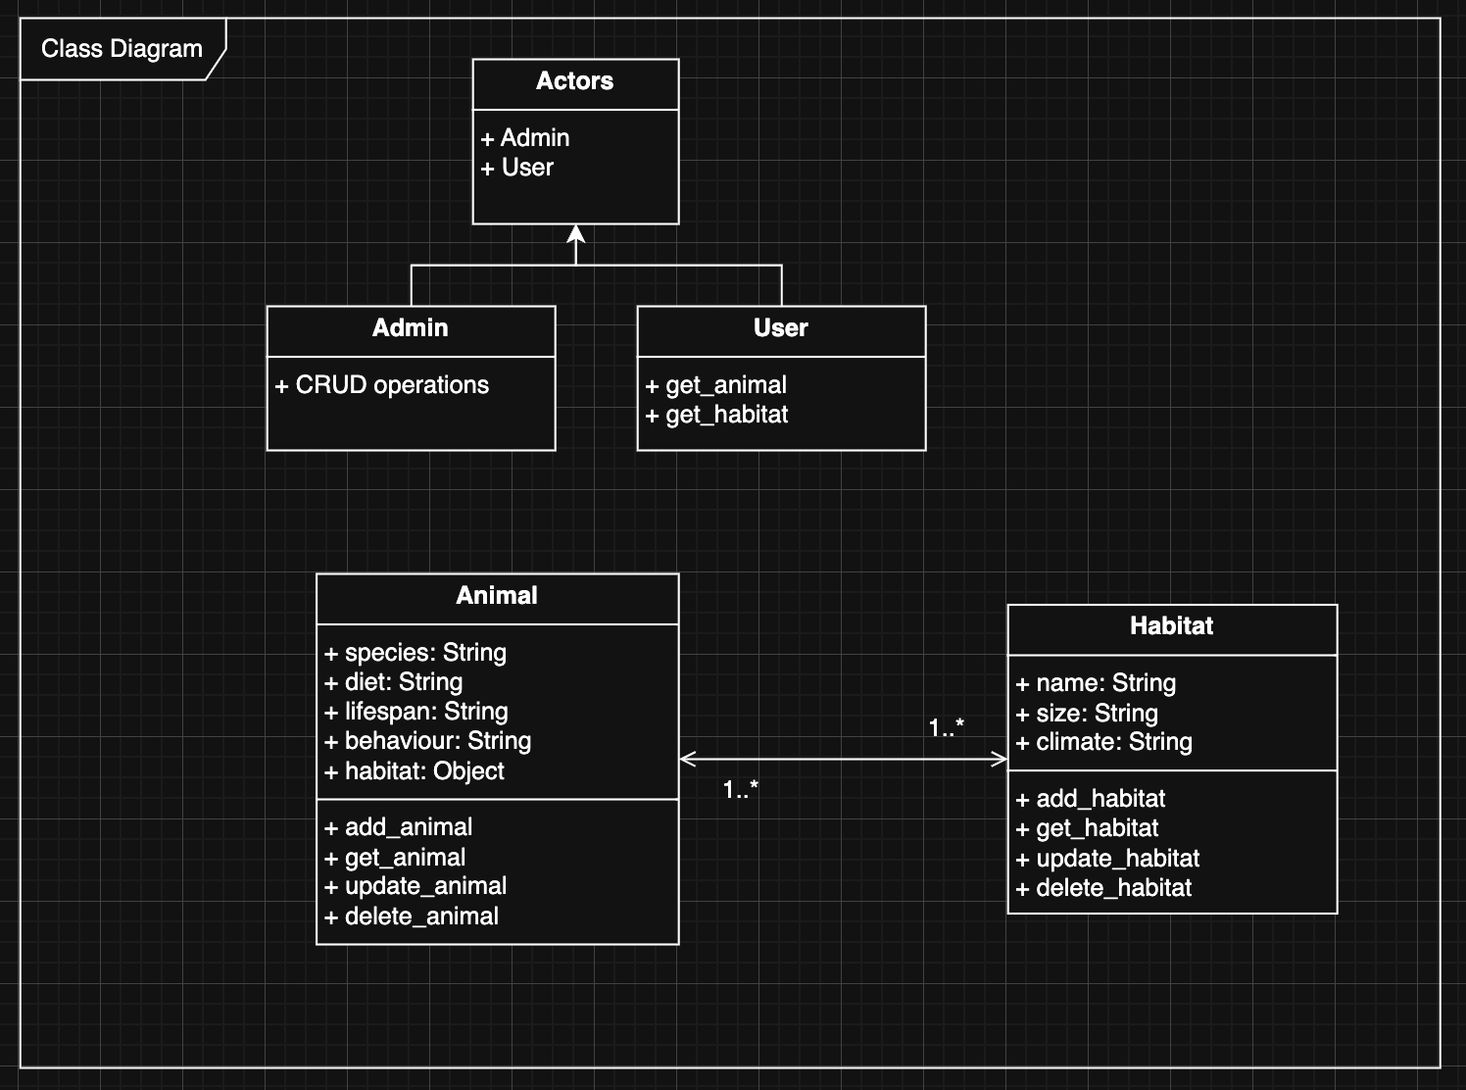
Class UML

Slide 5
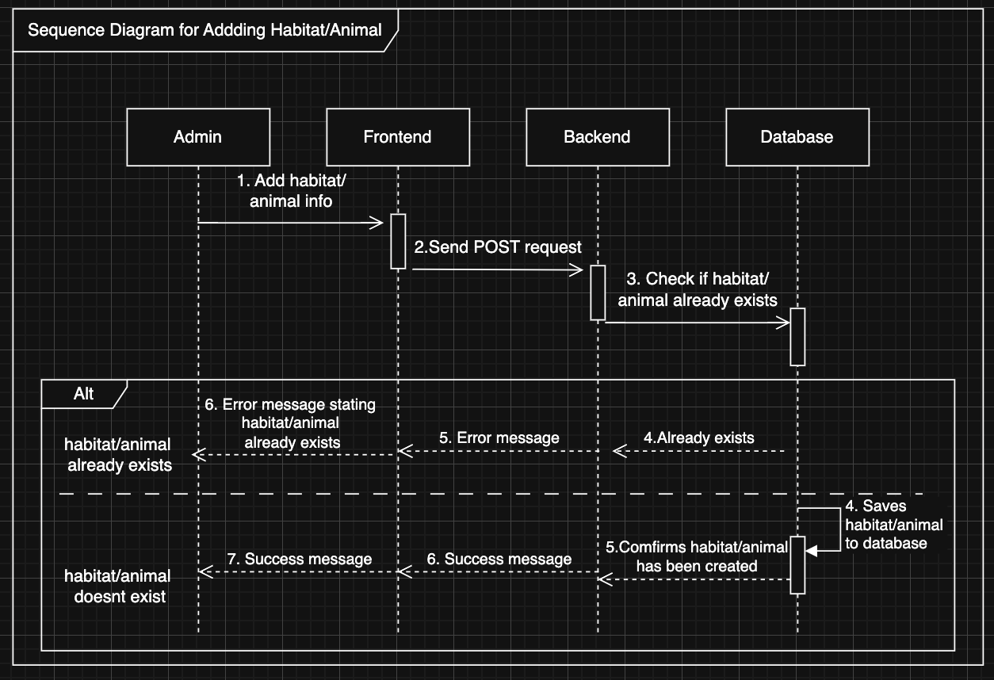
Sequence UML

Slide 6
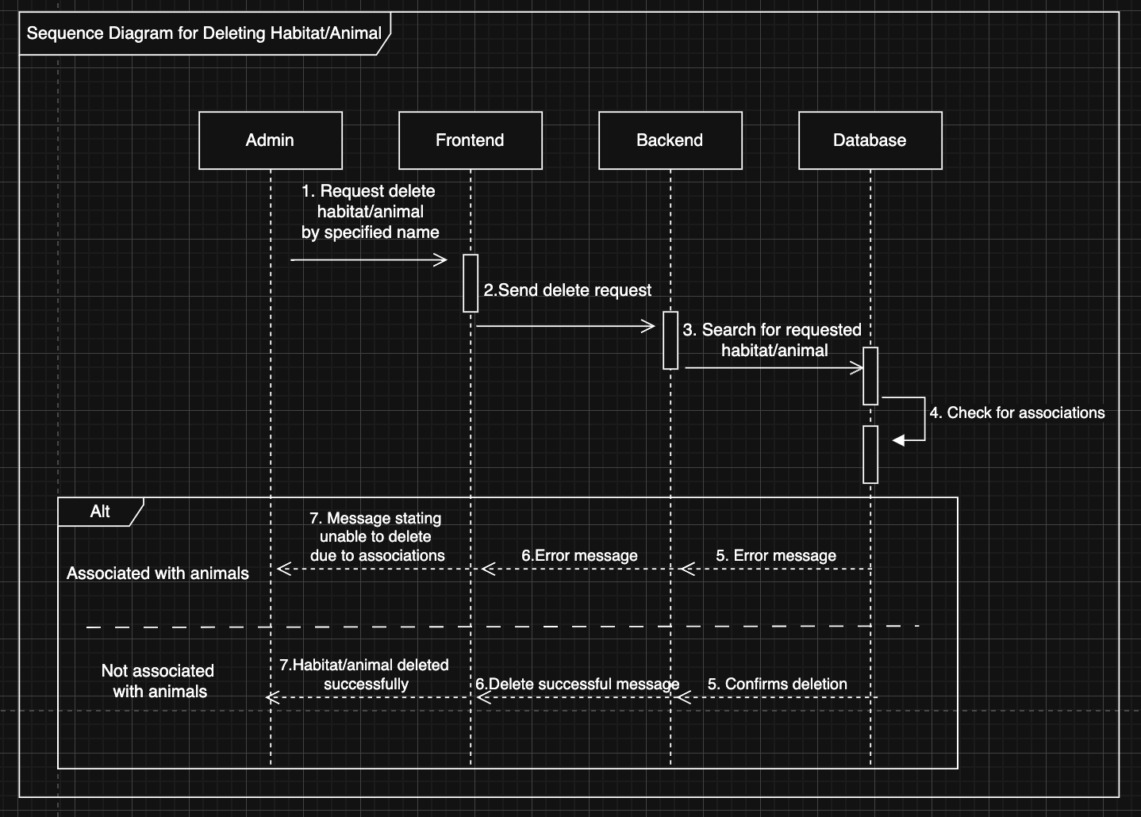
Sequence UML

Slide 7
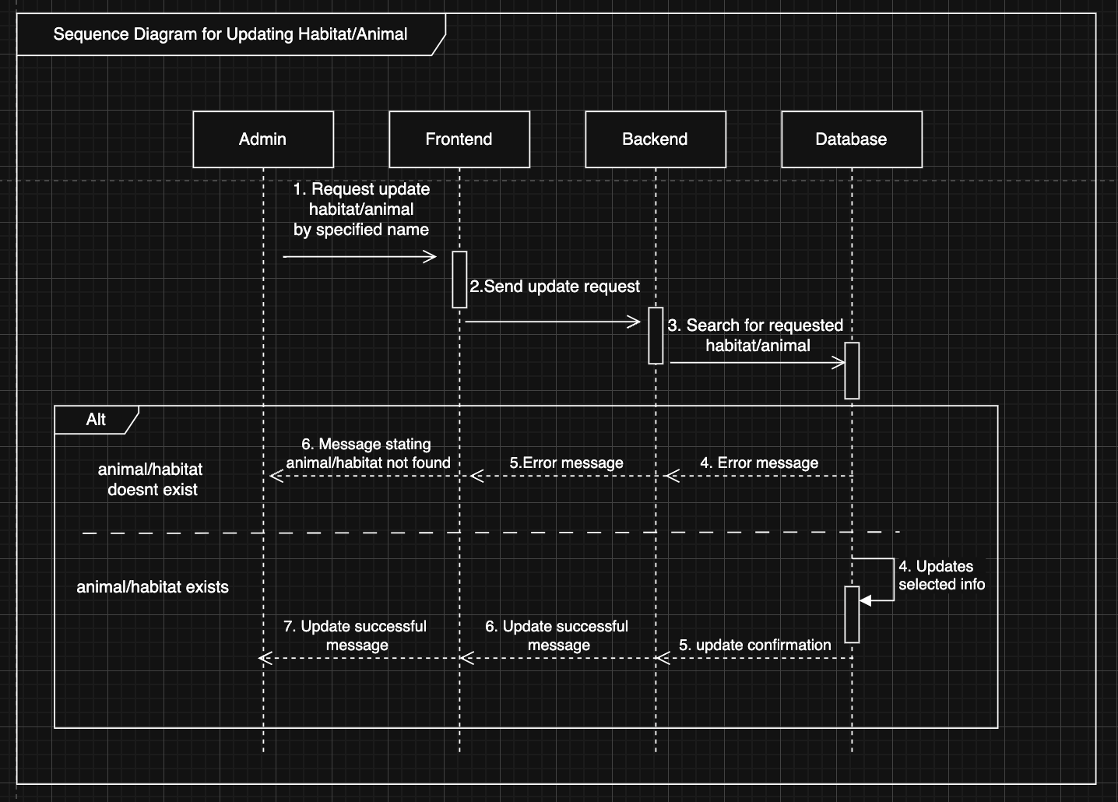
Sequence UML

Slide 8
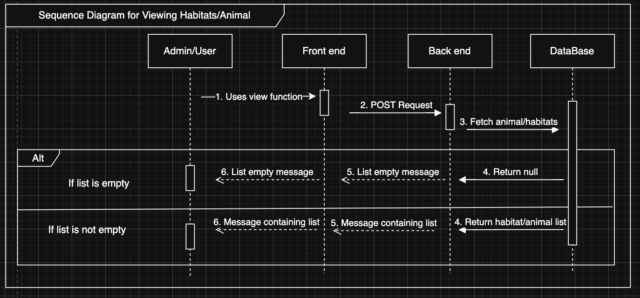
Sequence UML

